Slide 1
Machine Learning 09- Unsupervised Learning
Dr. Malak Abdullah
Computer Science Department
Jordan University of Science and Technology

Slide 2
We will cover two topics
Unsupervised learning (ch 9)
Dimensionality Reduction (ch 8)

Slide 3
Unsupervised Learning

Slide 4
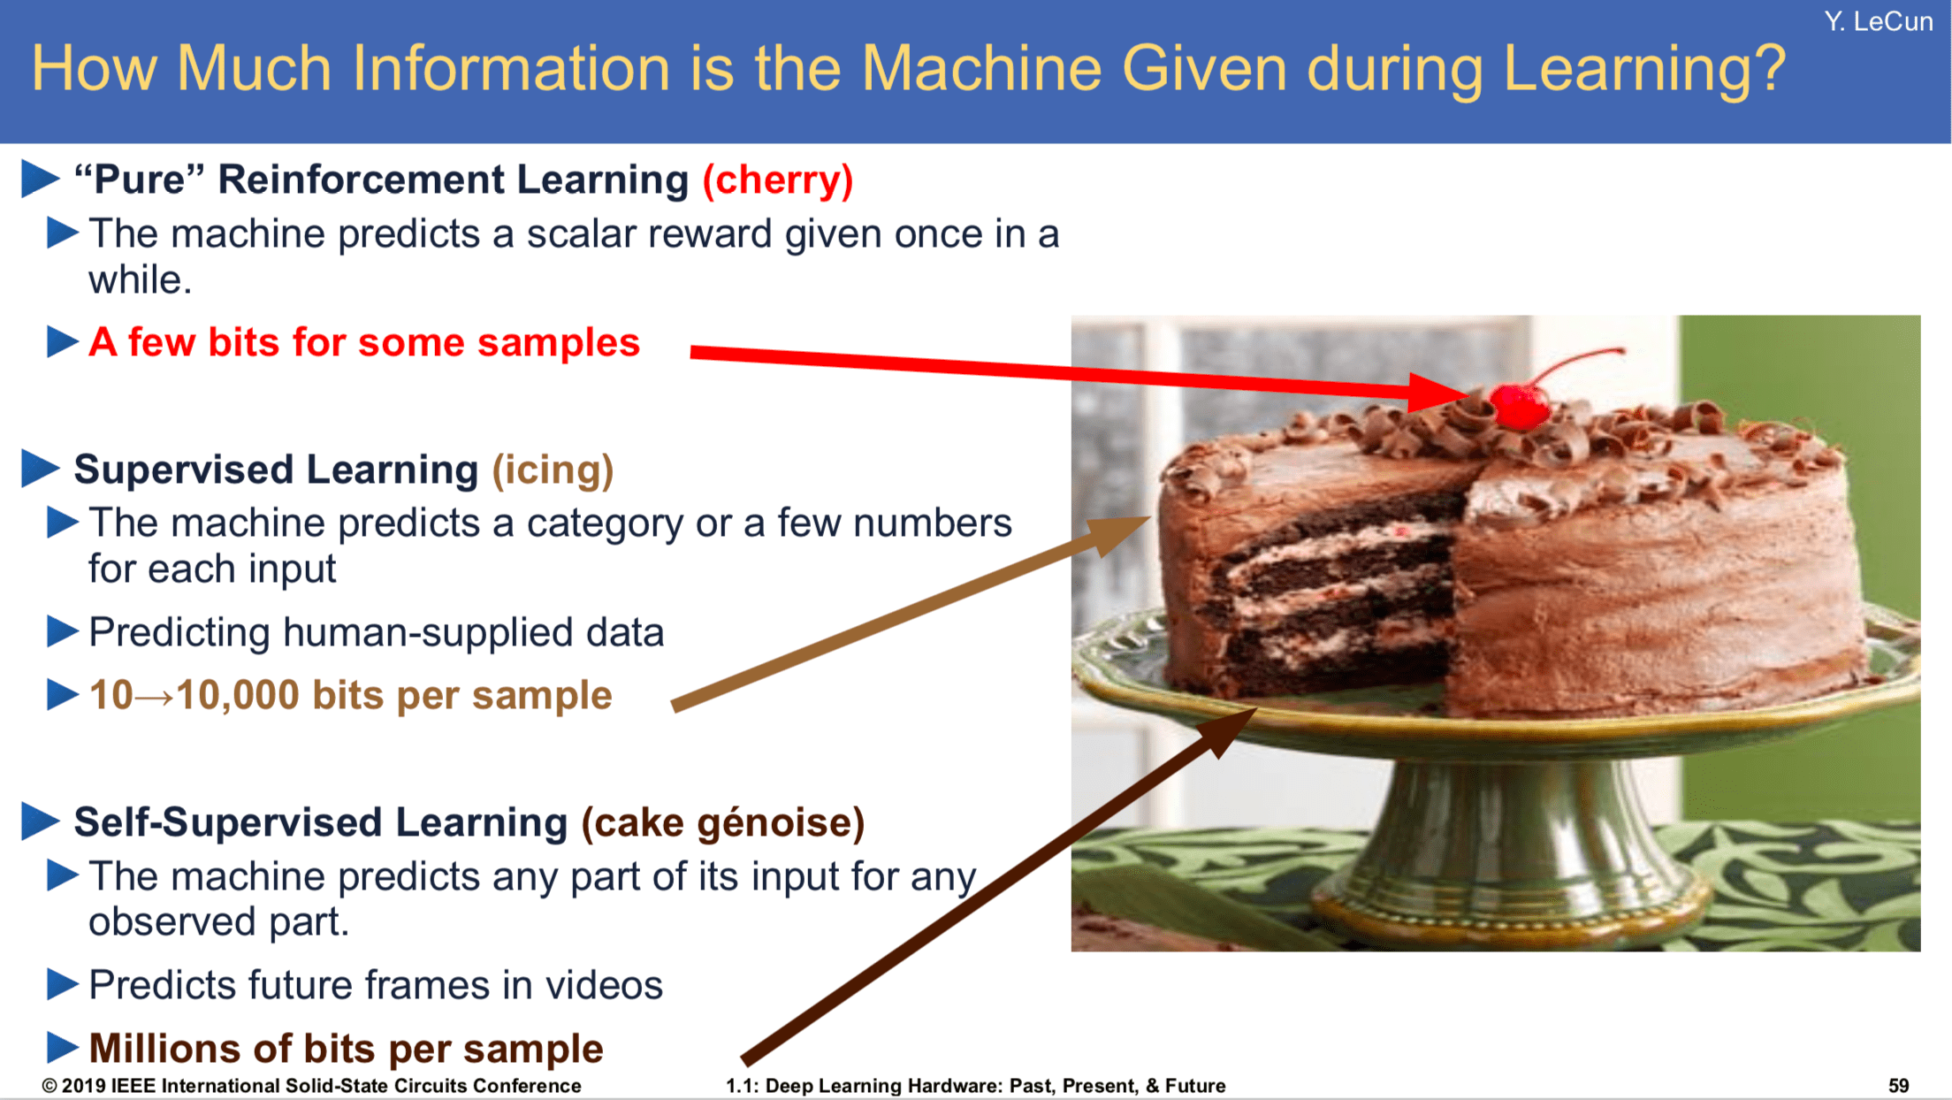

Slide 5
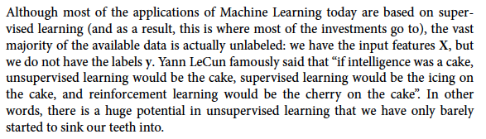
Unsupervised learning
the icing on the cake definition: 1. something that makes a good situation even better: 2. an unexpected additional good thing

Slide 6
Supervised learning vs. unsupervised learning
Supervised learning: discover patterns in the data that relate data attributes with a target (class) attribute.
These patterns are then utilized to predict the values of the target attribute in future data instances.
Unsupervised learning: The data have no target attribute.
We want to explore the data to find some intrinsic structures in them.

Slide 7
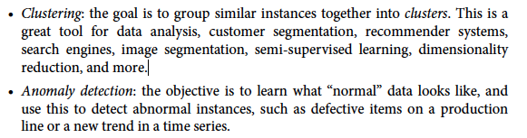
unsupervised learning tasks and algorithms:

Slide 8
Clustering
Clustering is a technique for finding similarity groups in data, called clusters. I.e., It groups data instances that are similar to (near) each other in one cluster and data instances that are very different (far away) from each other into different clusters.
Clustering is often called an unsupervised learning task as no class values denote a priori grouping of the data instances that are given, which is the case in supervised learning.
Due to historical reasons, clustering is often considered synonymous with unsupervised learning.

Slide 9
Clustering
It is the task of identifying similar instances and assigning them to clusters, i.e., groups of similar cases.
It is helpful for customer segmentation: You can cluster your customers based on their purchases, their activity on your website, and so on. This helps you understand who your customers are and what they need so you can adapt your products and marketing campaigns to each segment. For example, it can be useful in recommender systems to suggest content that other users in the same cluster enjoy.
It is also useful for data analysis: when analyzing a new dataset, it is often useful to first discover clusters of similar instances, as it is often easier to analyze clusters separately.
For semi-supervised learning, if you only have a few labels, you could perform clustering and propagate the labels to all the instances in the same cluster.

Slide 10
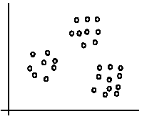
An illustration
The data set has three natural groups of data points, i.e., 3 natural clusters.

Slide 11
What is clustering for?
Let us see some real-life examples:
Example 1: groups people of similar sizes together to make “small”, “medium” and “large” T-Shirts. ☺
Tailor-made for each person: too expensive ☹
One-size-fits-all: does not fit all. ☹
Example 2: In marketing, segment customers according to their similarities
To do targeted marketing.

Slide 12
What is clustering for? (cont…)
Example 3: Given a collection of text documents, we want to organize them according to their content similarities,
To produce a topic hierarchy
In fact, clustering is one of the most utilized data mining techniques.
It has a long history and is used in almost every field, including medicine, psychology, botany, sociology, biology, archeology, marketing, insurance, and libraries.
In recent years, due to the rapid increase of online documents, text clustering has become important.

Slide 13
Aspects of clustering
A clustering algorithm
Partitional clustering
Hierarchical clustering
…
A distance (similarity, or dissimilarity) function
Clustering quality
Inter-clusters distance ⇒ maximized
Intra-clusters distance ⇒ minimized
The quality of a clustering result depends on the algorithm, the distance function, and the application.

Slide 14
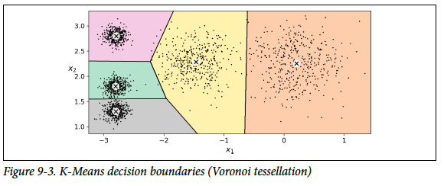
Clustering Algorithm
There is no universal definition of what a cluster is: it really depends on the context, and different algorithms will capture different kinds of clusters. For example, some algorithms look for instances centered around a particular point, called a centroid. Others look for continuous regions of densely packed instances: these clusters can take on any shape. Some algorithms are hierarchical, looking for clusters of clusters. And the list goes on.
In this class we will look at clustering algorithms K-Means

Slide 15
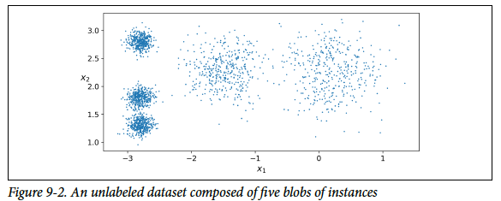
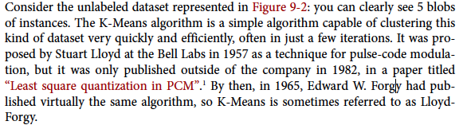

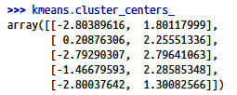
K-Means

Slide 16
K-means algorithm
Given k, the k-means algorithm works as follows:
Randomly choose k data points (seeds) to be the initial centroids, cluster centers
Assign each data point to the closest centroid
Re-compute the centroids using the current cluster memberships.
If a convergence criterion is not met, go to 2).

Slide 17
Soft Clustering
Instead of assigning each instance to a single cluster, which is called hard clustering, it can be useful to just give each instance a score per cluster: this is called soft clustering.

Slide 18
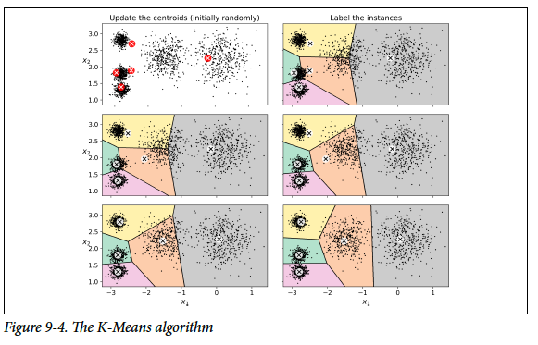
How does Clustering work?
start by placing the centroids randomly (e.g., by picking k instances at random and using their locations as centroids). Then label the instances, update the centroids, label the instances, update the centroids, and so on until the centroids stop moving. The algorithm is guaranteed to converge in a finite number of steps (usually quite small), it will not oscillate forever2. You can see the algorithm in action in Figure 9-4

Slide 19
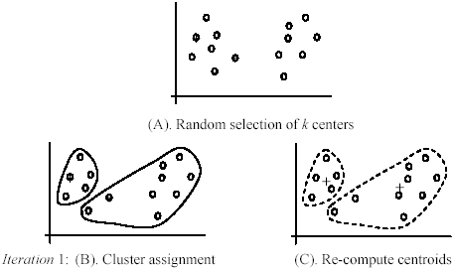
An example
+
+

Slide 20
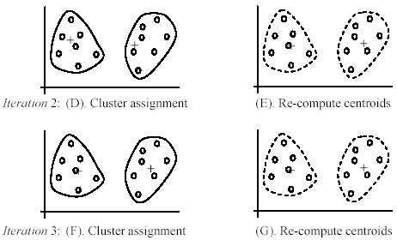
An example (cont …)

Slide 21
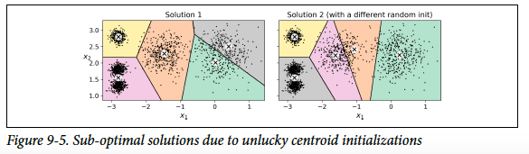
Not the right solution
Unfortunately, although the algorithm is guaranteed to converge, it may not converge to the right solution (i.e., it may converge to a local optimum): this depends on the centroid initialization. For example, Figure 9-5 shows two sub-optimal solutions that the algorithm can converge to if you are not lucky with the random initialization step
So, we need Centroid Initialization Methods.

Slide 22
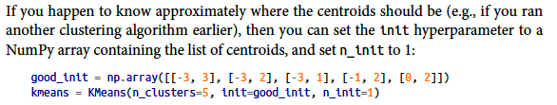

Centroid Initialization Methods
But how exactly does it know which solution is the best? Well, of course, it uses a performance metric! It is called the model’s inertia: this is the mean squared distance between each instance and its closest centroid.
It is roughly equal to 223.3 for the model on the left of Figure 9-5, 237.5 for the model on the right of Figure 9-5, and
211.6 for the model in Figure 9-3. The Kmeans class runs the algorithm n_init times and keeps the model with the lowest inertia: in this example, the model in Figure 9-3 will be selected

Slide 23
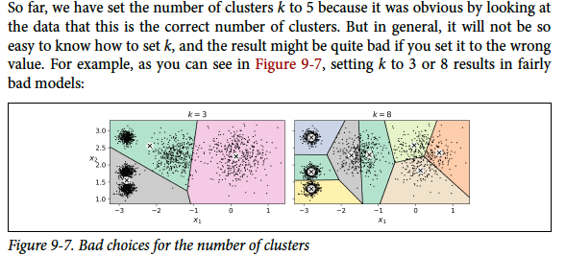
Finding the Optimal Number of Clusters

Slide 24
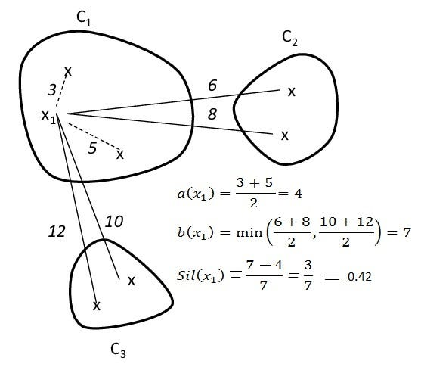
How to choose the number of clusters
Unfortunately, it is not that simple. The more clusters there are, the closer each instance will be to its closest centroid and, therefore, the lower the inertia will be.
Use the silhouette score, which is the mean silhouette coefficient over all the instances. An instance’s silhouette coefficient is equal to (b – a) / max(a, b) where a is the mean distance to the other instances in the same cluster (it is the mean intra-cluster distance), and b is the mean nearest-cluster distance, that is the mean distance to the instances of the next closest cluster (defined as the one that minimizes b, excluding the instance’s own cluster).

Slide 25
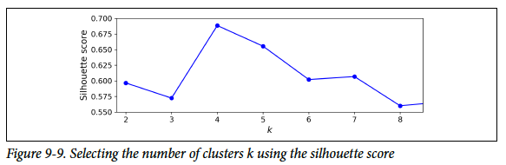
Using Silhouette score
The silhouette coefficient can vary between -1 and +1: a coefficient close to +1 means that the instance is well inside its own cluster and far from other clusters. In contrast, a coefficient close to 0 means that it is close to a cluster boundary, and finally, a coefficient close to -1 means that the instance may have been assigned to the wrong cluster.
To compute the silhouette score, you can use Scikit-Learn’s silhouette_score() function, giving it all the instances in the dataset, and the labels they were assigned:
As you can see, this visualization is much richer than the previous one: in particular, although it confirms that k=4 is a very good choice, it also underlines the fact that k=5 is quite good as well, and much better than k=6 or 7. This was not visible when comparing inertias.

Slide 26
Limits of K-Means
Despite its many merits, most notably being fast and scalable, K-Means is not perfect.
As we saw, the algorithm must be run several times to avoid sub-optimal solutions, and you need to specify the number of clusters, which can be quite a hassle.
Moreover, K-Means does not behave very well when the clusters have varying sizes, different densities, or non-spherical shapes.
Note: It is important to scale the input features before you run K-Means, or else the clusters may be very stretched, and K-Means will perform poorly. Scaling the features does not guarantee that all the clusters will be nice and spherical, but it generally improves things.

Slide 27
Weaknesses of k-means
The algorithm is only applicable if the mean is defined.
For categorical data, k-mode - the centroid is represented by most frequent values.
The user needs to specify k.
The algorithm is sensitive to outliers
Outliers are data points that are very far away from other data points.
Outliers could be errors in the data recording or some special data points with very different values.

Slide 28
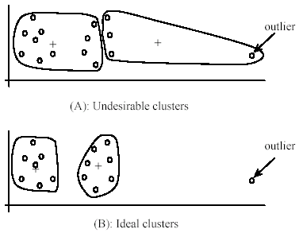
Weaknesses of k-means: Problems with outliers

Slide 29
Weaknesses of k-means: To deal with outliers
One method is to remove some data points in the clustering process that are much further away from the centroids than other data points.
To be safe, we may want to monitor these possible outliers over a few iterations and then decide to remove them.
Another method is to perform random sampling. Since in sampling we only choose a small subset of the data points, the chance of selecting an outlier is very small.
Assign the rest of the data points to the clusters by distance or similarity comparison, or classification

Slide 30
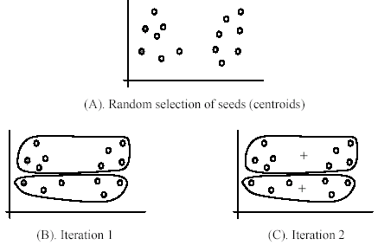
Weaknesses of k-means (cont …)
The algorithm is sensitive to initial seeds.

Slide 31
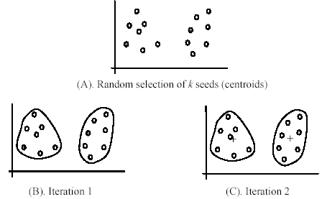
Weaknesses of k-means (cont …)
If we use different seeds: good results
There are some methods to help choose good seeds

Slide 32
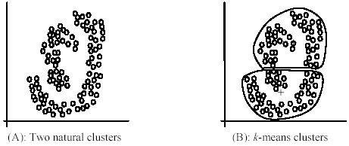
Weaknesses of k-means (cont …)
The k-means algorithm is not suitable for discovering clusters that are not hyper-ellipsoids (or hyper-spheres).
+

Slide 33
K-means summary
Despite weaknesses, k-means is still the most popular algorithm due to its simplicity, efficiency and
other clustering algorithms have their own lists of weaknesses.
No clear evidence that any other clustering algorithm performs better in general
although they may be more suitable for some specific types of data or applications.
Comparing different clustering algorithms is a difficult task. No one knows the correct clusters!

Slide 34
Using clustering for image segmentation
Image segmentation is the task of partitioning an image into multiple segments.
In semantic segmentation, all pixels that are part of the same object type get assigned to the same segment.
For example, in a self-driving car’s vision system, all pixels that are part of a pedestrian’s image might be assigned to the “pedestrian” segment (there would just be one segment containing all the pedestrians).
In instance segmentation, all pixels that are part of the same individual object are assigned to the same segment. In this case there would be a different segment for each pedestrian. The state of the art in semantic or instance segmentation today is achieved using complex architectures based on convolutional neural networks (talk about this later).
Here, we are going to do something much simpler: color segmentation. We will simply assign pixels to the same segment if they have a similar color.

Slide 35


How it works?
The image is represented as a 3D array: the first dimension’s size is the height, the second is the width, and the third is the number of color channels, in this case red, green and blue (RGB).
In other words, for each pixel there is a 3D vector containing the intensities of red, green and blue, each between 0.0 and 1.0 (or between 0 and 255 if you use imageio.imread()).
Some images may have less channels, such as grayscale images (one channel), or more channels!
The following code reshapes the array to get a long list of RGB colors, then it clusters these colors using K-Means. For example, it may identify a color cluster for all shades of green. For example, all shades of green may be replaced with the same light green color (assuming the mean color of the green cluster is light green). Finally it reshapes this long list of colors to get the same shape as the original image. And we’re done!

Slide 36
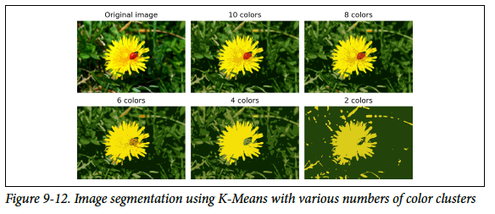

Slide 37
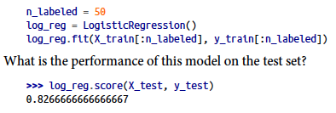
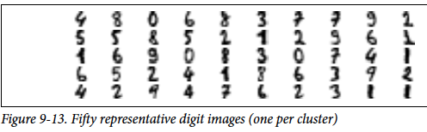

Using Clustering for Semi-Supervised Learning
Another use case for clustering is in semi-supervised learning, when we have plenty of unlabeled instances and very few labeled instances. Let’s train a logistic regression model on a sample of 50 labeled instances from the digits dataset:
First, let’s cluster the training set into 50 clusters, then for each cluster let’s find the image closest to the centroid. We will call these images the representative images:

Slide 38


Continue…
Now let’s look at each image and manually label it:
y_representative_digits = np.array([4, 8, 0, 6, 8, 3, ..., 7, 6, 2, 3, 1, 1])
Now we have a dataset with just 50 labeled instances, but instead of being completely random instances, each of them is a representative image of its cluster.
But perhaps we can go one step further: what if we propagated the labels to all the other instances in the same cluster? This is called label propagation:
We got a tiny little accuracy boost. Better than nothing, but not astounding. The problem is that we propagated each representative instance’s label to all the instances in the same cluster, including the instances located close to the cluster boundaries, which are more likely to be mislabeled. Let’s see what happens if we only propagate the labels to the 20% of the instances that are closest to the centroids:

Slide 39
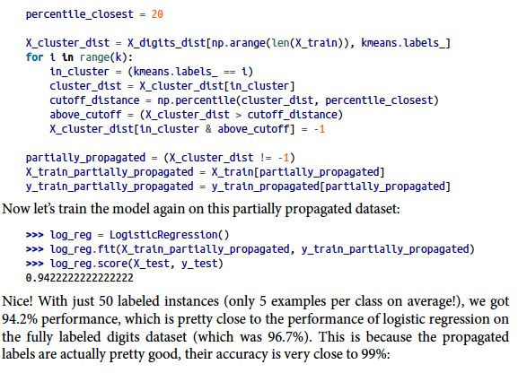
Continue

Slide 40
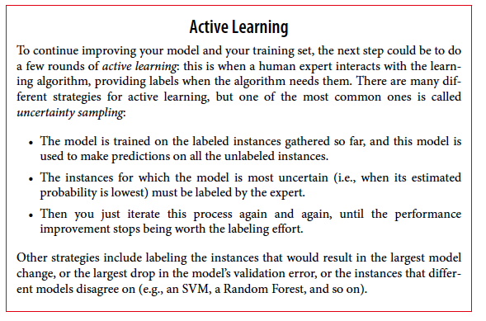

Slide 41
Dimensionality Reduction

Slide 42
Overview
One of the common problems in machine learning is ‘Overfitting’, where the model remembers all the training data, including noise and other unrelated features, predicts higher accuracy on training data, but does not generalize well to the new dataset.
Key reason for overfitting is that the model is too complex relative to the amount and noisiness of the training data.
How to solve overfitting?
The model can be simplified by selecting simple algorithms, reducing the number of parameters used, or removing noise in the training data, e.g., outliers.

Slide 43
Dimensionality Reduction
In order to reduce complexity by reducing features/ dimensions,
Dimensionality reduction plays a critical role by projecting the dataset onto a lower-dimensional space.
In other words, dimension reduction is basically a pre-processing step for machine learning that reduces the dimension of the dataset.
It is essential to come up with a good set of features to train by: – Add / Discard features – Derive new feature space

Slide 44

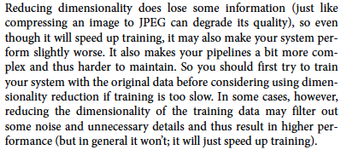
The Curse of Dimensionality

Slide 45
Feature Engineering
1. Feature Selection
It includes creation of subset from the original dataset which includes selecting the most useful feature to train and has lower prediction error than on full model. In this process, some variables are retained or discarded.
2. Feature Extraction
This involves reducing or transforming the data to a lower dimensional space with most relevant information / features.
Common feature extraction methods are:
PCA (Principal Component Analysis)
LDA (Linear Discriminant Analysis) we will not talk about this in the current course

Slide 46
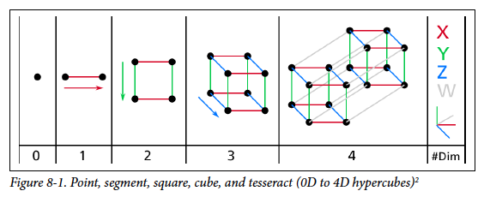
Dimensionality reduction
It reduces the dimensions of a d-dimensional dataset by projecting it onto a (k)-dimensional subspace (where k<d) in order to increase the computational efficiency while retaining most of the information.
Dimensionality reduction implies information loss !!
Transformation
This transformation is defined so that the first principal component has the largest possible variance, and each succeeding component, in turn, has the next highest possible variance.

Slide 47
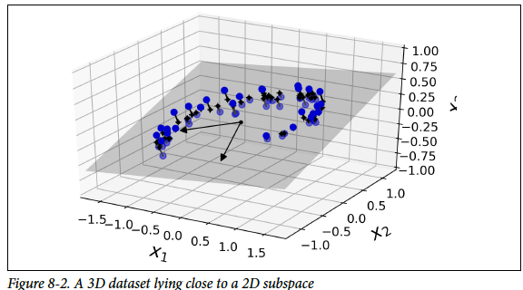
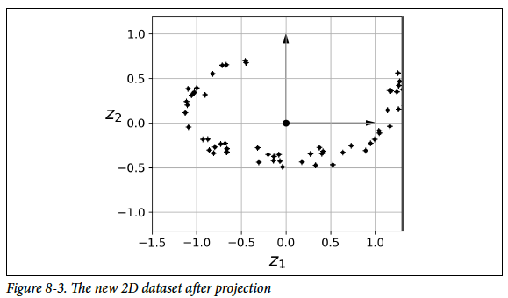
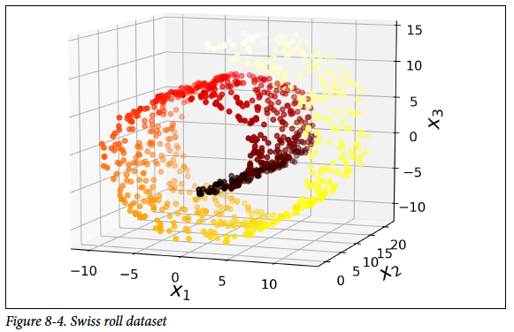
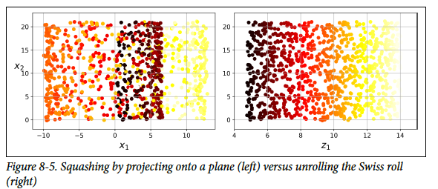
Two Approaches for Dimensionality Reduction
Projection
Manifold Learning

Slide 48
How Does PCA Work?
Principal Component Analysis (PCA) is an unsupervised learning algorithm that ignores the class labels. We need to find (the so-called principal components) that maximize the variance in a dataset to find the directions.
To obtain quality/type of coffee, we can use different features of coffee such as its sweetness value, color of coffee, place of coffee and so on, however, many of these features will be redundant or dummy feature variables (can be derived from other features), therefore causing to train model on unnecessary features. In short, we can get the type of coffee with fewer feature variables, and this is what PCA actually does inside the box.
Note that PCA does not select a set of features and discard other features; rather, it infers some new features that best describe the type of class from the existing features.
First, it identifies the hyperplane that lies closest to the data and then projects the data onto it. In other words, PCA is basically the summarization of data.

Slide 49
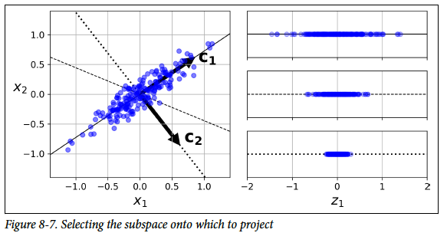
How Does PCA Work?
On the right is the result of the projection of the dataset onto each of these axes. As you can see, the projection onto the solid line preserves the maximum variance, while the projection onto the dotted line preserves very little variance, and the projection onto the dashed line preserves an intermediate amount of variance.
It seems reasonable to select the axis that preserves the maximum amount of variance, as it will most likely lose less information than the other projections.

Slide 50
what the word ‘variance’ has to do with PCA?
Imagine that you land up with a set of features that are unable to distinguish the types of coffee; therefore, these features are useless. This type of dimensionality reduction will deteriorate your model accuracy and, in some cases, lead to under-fitting of data.
Therefore, PCA looks for properties that show as much variation across datasets as possible.
Now imagine that we compose a square matrix of numbers that describe the variance of the data and the covariance among variables. This is the covariance matrix. It is an empirical description of the data we observe.
PCA works on eigenvectors and eigenvalues of the covariance matrix, which is the equivalent of fitting those straight, principal-component lines to the variance of the data. Why? Because eigenvectors trace the principal lines of force, In other words, PCA determines the lines of variance in the dataset which are called as principal components with the first principal component having the maximum variance, second principal component having second maximum variance and so on.

Slide 51
Let’s Perform the PCA and analyze the graph:
1. Loading the dataset to the memory and performing feature extraction. 2. Scaling the dataset – Can use min-max normalization for scaling the dataset with mean zero and a unit standard deviation. 3. Apply PCA with inbuilt PCA function in sklearn:
from sklearn.decomposition import PCA pca = PCA (n_components=2) X_feature_reduced = pca.fit(X).transform(X)
Here, ‘X’ is the training dataset and ‘n_component’ is the number of PCA components we want to derive from our existing feature set.
So using the sklearn, PCA is like a black box (black box working explained above), you give scaled feature set as an input to sklearn PCA and get PCA components as output which can be used as an input to data training algorithms.

Slide 52
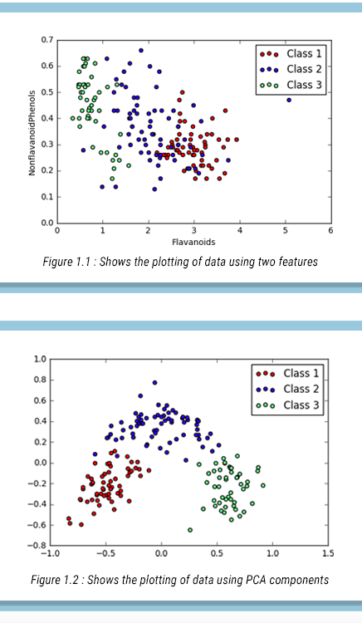
The graph above shows the plotting of data points using two features vs. the Plotting of data points using principal components (which is basically a summarization of all the features in our dataset)

Slide 53
How Does LDA Work?
Linear Discriminant Analysis is a supervised algorithm that considers the class label. It is a way to reduce ‘dimensionality’ while preserving as much of the class discrimination information as possible.
LDA helps you find the boundaries around clusters of classes.
It projects your data points on a line so that your clusters are as separated as possible, with each cluster having a relative (close) distance to a centroid.
LDA finds a centroid of each class data point. For example, with thirteen different features, LDA will find the centroid of each class using the thirteen different feature datasets. Now based on this, it determines a new dimension which is nothing but an axis which should satisfy two criteria:
Maximize the distance between the centroid of each class.
Minimize the variation (which LDA calls scatter and is represented by s2) within each category.

Slide 54
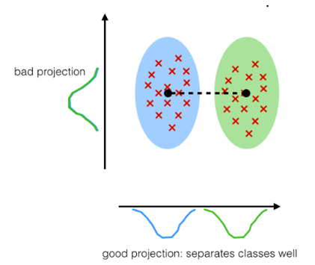
Therefore the gist is:
(meana – meanb)/(Sa – Sb) = ideally large/ideally small
Note: Here ‘mean’ is the centroid of the class. Variation is the spread of data over the plane.
So, if the variation of data is minimum, then less overlapping between the classes will be there and maximum separation will be maintained between the different classes.
So whichever co-ordinate of the new axis satisfies these two criteria, they form the new dimension of dataset.

Slide 55
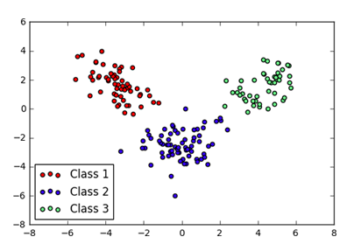
Let’s perform the LDA and analyse the graph:
1. Loading the dataset to the memory and performing feature extraction. 2. Scaling the dataset – Can use min-max normalization for scaling the dataset with mean zero and a unit standard deviation. 3. Apply LDA with inbuilt LDA function in sklearn
from sklearn.decomposition import LDA lda = LDA(n_components=2) X_feature_reduced = lda.fit(X).transform(X)
the graph of two LDA components (LDA1 and LDA2) obtained by applying LDA (plotted using matplotlib scatterplot)
Maximize the between class measure & minimize the within class measure.

Slide 56
In the graph, you can visualize the whole dataset properly differentiate well among the classes. This is the major difference between PCA and LDA.
To conclude, PCA performs better in case where number of samples per class is less. Whereas LDA works better with large dataset having multiple classes; class separability is an important factor while reducing dimensionality.
Ref:
http://www.vfirst.com/blog/techfirst/dimension-reduction-techniques-pca-vs-lda-in-machine-learning-part-2/

